Slide 1

SAP Analytics cloud training
Anubhav Oberoy
Day 18

Slide 2
End of Day 18

Slide 3
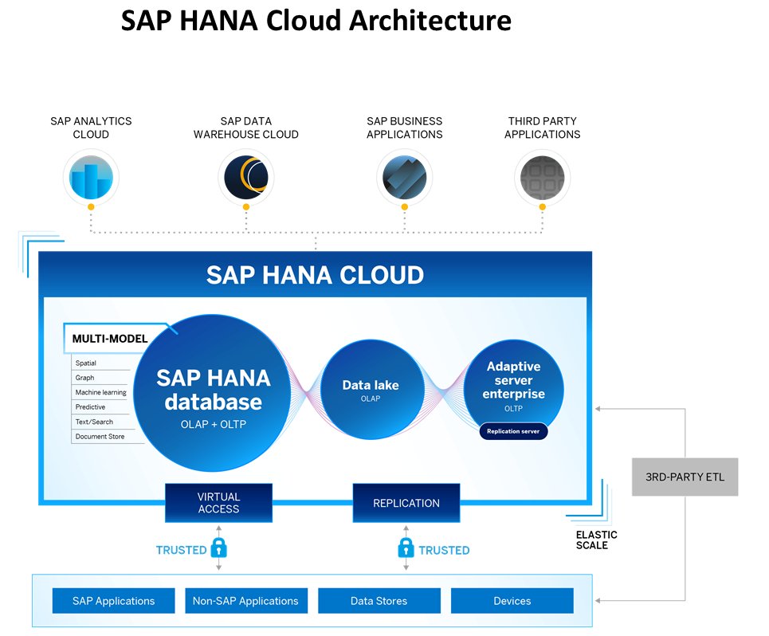
What is SAP HANA Cloud?
SAP HANA Cloud is a fully managed, in-memory, cloud database as a service (DBaaS). It is the cloud-based data foundation for SAP Business Technology Platform. With SAP HANA Cloud you can create, run, and extend new and existing applications.
SAP HANA Cloud includes a number of software components. The core component is SAP HANA Database, but other components can be added at any time, such as a data lake.
Key Components of SAP HANA Cloud
There are four key components of SAP HANA Cloud:
SAP HANA Cloud, SAP HANA Database
In-memory database with built-in advanced analytics (spatial, graph, text, etc.)
SAP HANA Cloud, data lake
Store and query large data sets and most file types
SAP HANA Cloud, adaptive server enterprise
Support for extreme –performance transactional applications
SAP HANA Cloud, adaptive server enterprise replication
Bi-directional real time data replication across databases

Slide 4
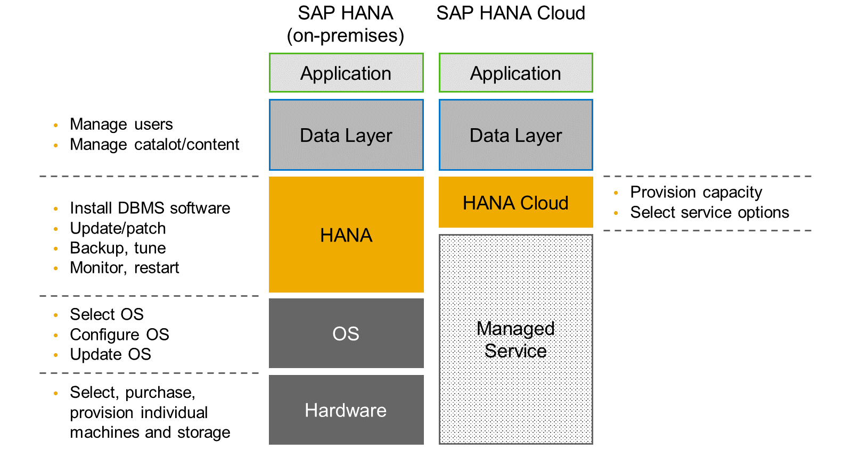
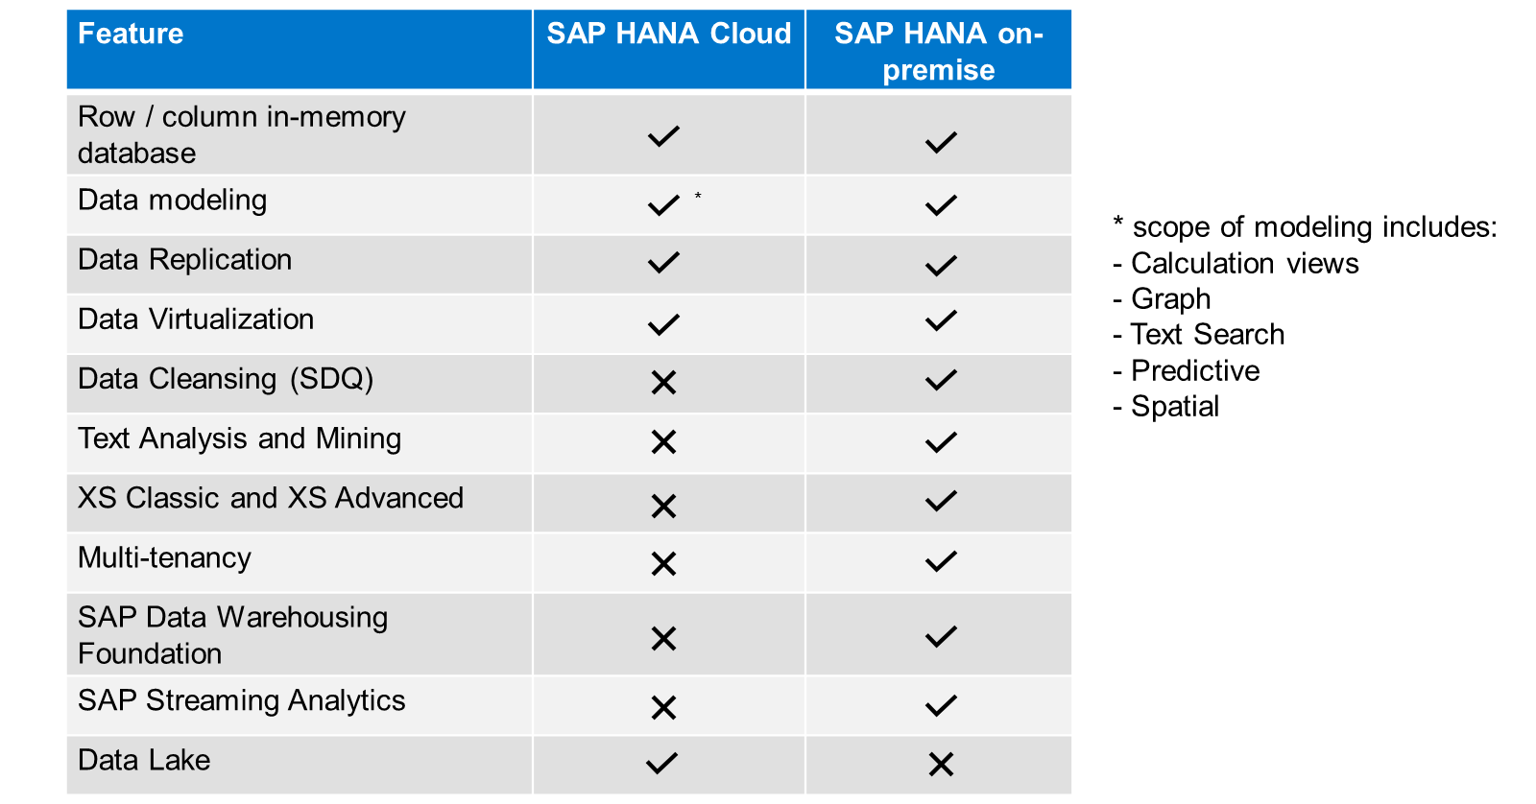
HANA Cloud v/s On-premise
Feature Differences
SAP HANA Cloud compares very closely with SAP HANA on-premise in terms of features but there are some differences.

Slide 5
What is Schema in HANA
Schema – Is a mandatory database object of database which stores other database objects.
It’s a logical separation of database objects.
It is home of all the runtime object
Security
Package – home of design time object
BW
ekko
ECC
ekko
S/4HANA
ekko
SAP HANA 600GB
SCBW
ekko
ECC001
ekko
SAPS4C
ekko
MIG
ekko
SYS

Slide 6
HDI Container
An HDI Container is also a schema. But it is managed differently from a normal schema.
How its created?
Manually create it in BTP
Application Managed HDI Container (You as developer ONLY work with App, App will talk to HANA to create and manage this schema to store/read data internally)
You cant access HDI Container using HANA Studio (Deprecated tool), We can use new SAP HANA Database Explorer, SAP HANA WebIDE for OP or BAS to access HDI Container.
Who creates it?
There is a new service in SAP HANA called SAP HDI (HANA Deployer Infrastructure) which is just a microservice responsible to managing the container. HDI Deployer is a component which is used to talk to this service from our app.
Who owns it?
The moment HDI Container is created, 2 users will gets created automatically by system in HANA.
RANDOMGUID_DT (Design Time) – Full permission to CREATE< DROP< ALTER DB object
RANDOMGUID_RT (Runtime User) – Only permissions to INSERT, UPDATE, DELETE data…
In case of app wants to talk to hana, these users will be used by our app. The same user will be available as environment variable in CF, VCAP_SERVICE.

Slide 7
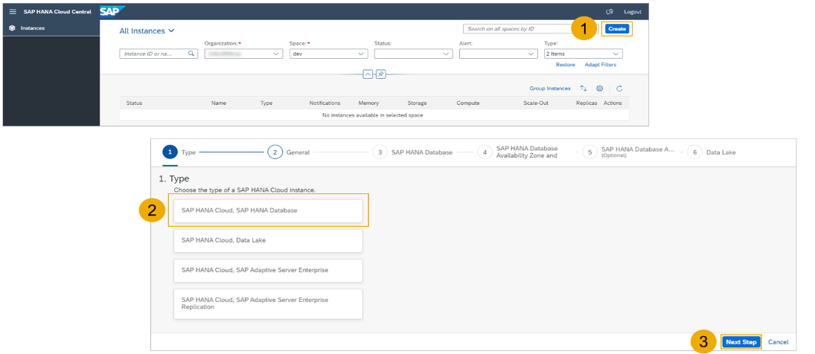
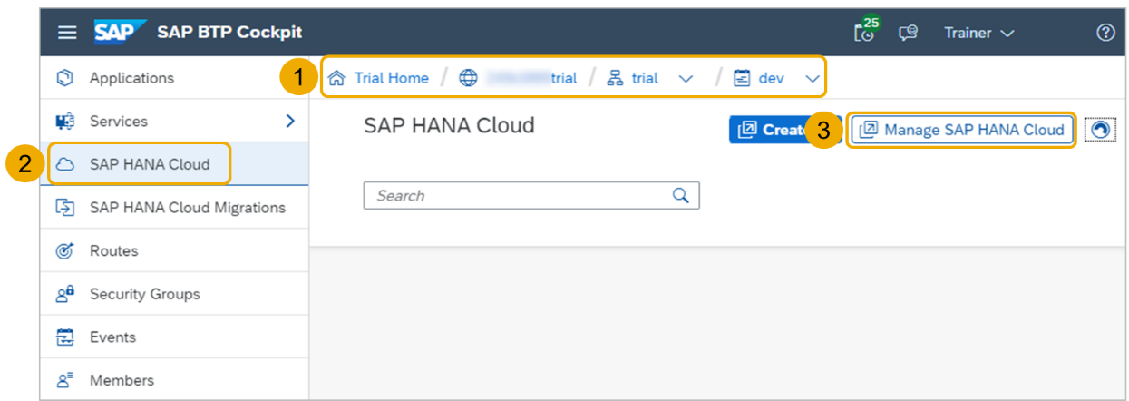
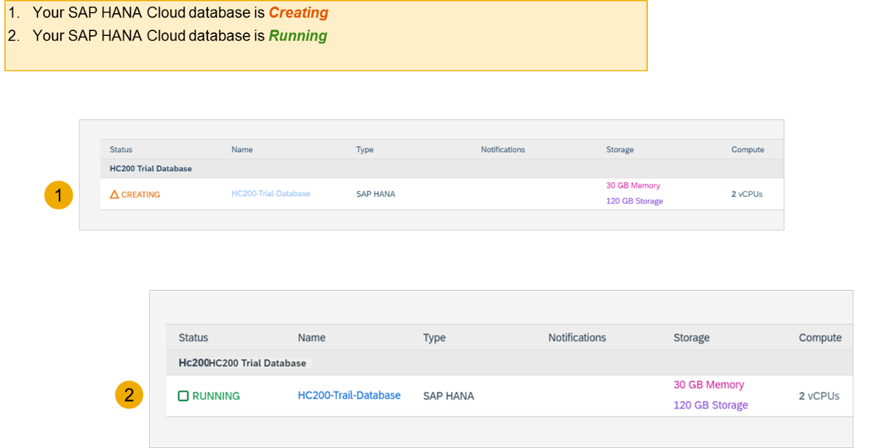
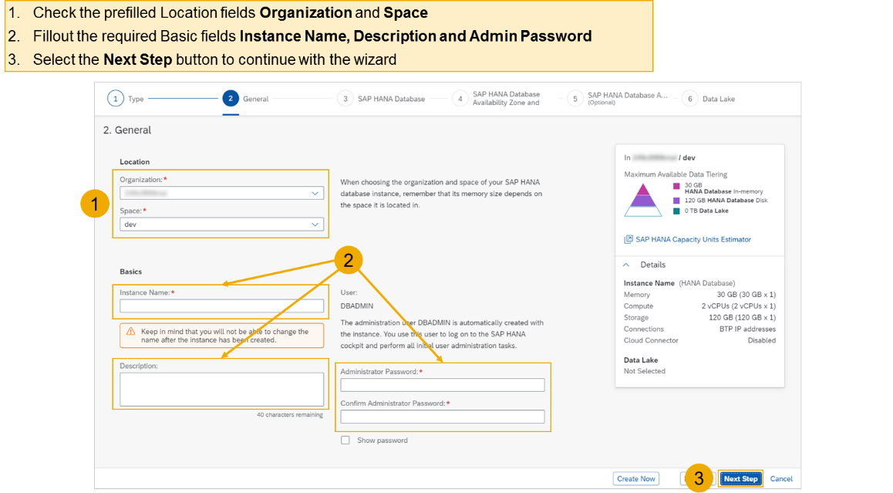
Create HANA Cloud Instance
Login to your trial and navigate to your dev space
Select SAP HANA Cloud
Select the Manage SAP HANA Cloud button to start the SAP HANA Cloud Central
Select the Create button to start the wizard
Select the SAP HANA Cloud instance Type to create
Select the Next Step button to continue

Slide 8

HANA Cloud
HANA Database running in the cloud. It is a database as a service offered in SAP BTP.
Create a free trial account - https://account.hanatrial.ondemand.com/trial/#/home/trial
When you create first time, you will get a data center screen, please choose USA data center
The system will create a trial global a/c, a sub account (USA) and a dev space
Go inside the dev space and choose SAP HANA Cloud
Create a new HANA Database, choose Signin with default IDP provider
Create a new HANA Database, and click Next Step
Enter DB instance as HANADB and password as Welcome1
Choose Next Step 2 times and select Allow all IP addresses
Go ahead review and finalize
It will take upto 20 minutes to create hana cloud instance.
www.anubhavtrainings.com

Slide 9
Live Data Connection with HANA Cloud
Install a generator (template)
Use generator to generate project
Download the Adaptor from sap site
Drag drop adaptor to the project
Build and deploy adapter project to SAP BTP
SAC
(SaaS to consume data and build dashboards)
SAP HANA Analytic Adapter
HANA Cloud
(HANA DB working as a Database as a service)
Create a HANA Cloud Instance in free trial a/c
Create a database project using BAS
Create a db table, interface, csv, Calc. view
Deploy these objects ➔ CUBE
www.anubhavtrainings.com

Slide 10
Step 1: HANA Native Development
Create a dev space in SAP Business application Studio tool with Full stack cloud development along with hana plugins being enabled
Select create project from template and choose HANA Database project
Enter project name, module name, namespace and bind to hana cloud instance Yes
Connect to our SAP BTP account by logging in using API end point url and provide dev space in dropdown
We give a unique container name (a container is a collection of all our database object, it contains tables, views, sequences, procedures, functions,..) ➔ anubhavhdi
A skeleton of project is created now.
Next step is to create a database table in that project under the src folder
Uploaded the table, tabledi, and csv from study material to src folder
Come down to hana project section and click rocket icon to deploy our objects
Press F1 key and open HANA Database Explorer tool where we can check our container and db objects
Add container to see our db table and open data to view data
Choose F1, Create new HANA Database artefact and choose calculation view
Create a calculation view with project node, select table and drag drop all fields, same for agg level
Make Id as dimension and deploy the view to hdi container
We can cross check the CUBE in HANA DB Explorer tool under container if its there or not.
www.anubhavtrainings.com

Slide 11
Step 2: Create Adapter for HANA int.
Press F1 and choose explore and install generator
Search for haa generator, choose the first one and install
F1 and choose Run generator and select haa:app generator from the list
Provide a project name as hanaadp
And now we give our container from from step 1 = anubhavhdi
A project skeleton is created, now we download an hana analytic adaptor and upload it to the project folder
To download it we goto https://tools.hana.ondemand.com/#hanatools
Download xsahaa-release-2.1.5-release.zip
Extract the zip and you see a folder created, from that folder drag java-xsahaa.war and drop to the BAS tool under project>hanadp>srv>target
Right click on mta.yaml and choose build MTA project
An mta_archieve folder with mtar gets created, Right click on mtar file and deploy MTAR
The application for adapter is very secure, we need to grant a role collection permission to even ourself to be able to consume data via this adapter (public cloud app)
Try to access adapter with URL – https://7e7b2249trial-dev-hanaadp.cfapps.us10-001.hana.ondemand.com/sap/bc/ina/service/v2/HeartBeat we get permission error
Now we go to sub account under security find role collection hanaadp_Viewer
Assign the role to our own user (email) and check heartbeat of ina service again
www.anubhavtrainings.com

Slide 12
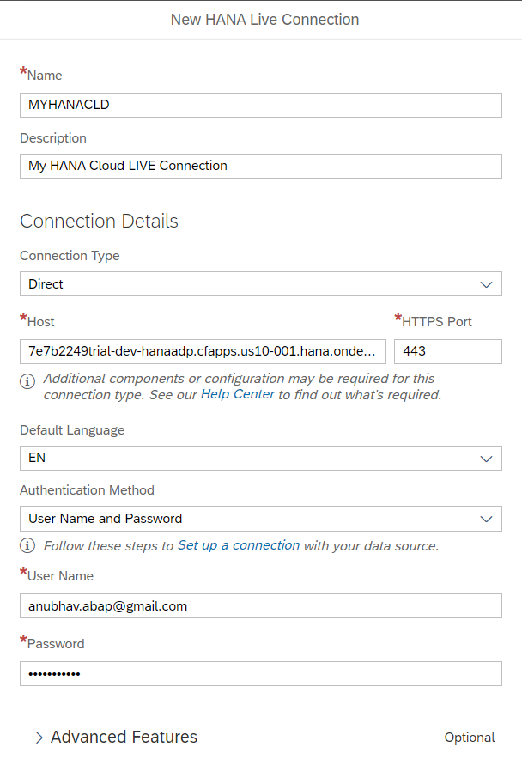
Step 3: SAC live connection to HANA
Switch over to SAC system
Go to connections and add a LIVE data connection with HANA Cloud
Choose Direction, enter the URL of adaptor with port no 443
Provide our SAP BTP user id and password with language EN
Click Create
www.anubhavtrainings.com

Slide 13

Questions

Slide 14

Anubhav Oberoy
anubhav.abap@gmail.com

